Slide 1


081100M01002H 图像处理与分析 第四讲: 图像变换 (II) 基本图像变换，频率域滤波，深度神经网络结构简介
Lecture 4 September 26, 2019

Slide 2
第二次编程小作业
第二次编程小作业已布置，发布时间是9月26日早上6:00。提交的截止时间是10月11日晚上11:00。
请注意，要求首先不使用函数如imfilter和conv2，直接从底层按数学公式实现，然后将结果与调用这些函数时的结果进行比较，检查是否一致。
编程平台：MATLAB, Python/PIL/Pillow, C++/OpenCV

Slide 3
关于编程作业答疑
编程作业答疑主要使用GitHub，网页地址
https://github.com/UCAS-IPA/IPA-discuss
提问时请先看一下是否已有相关论题，一般一次作业一个论题。
创建GitHub账户时请确保采用的电子邮件地址能接收到验证邮件。
如使用中遇到困难可微信联系助教。

Slide 4
ICIP 2019 简介
http://www.2019.ieeeicip.org/

Slide 5
CVPR 2019 简介
http://cvpr2019.thecvf.com/

Slide 6
内容提要
图像滤波和高斯滤波器
图像采样定理
图像的二维离散傅里叶变换
图像的频率域滤波
图像的正交变换
卷积神经网络的基本结构
点扩散函数的基本概念
Notes:
As you will see again and again in the class, to understand bioimage informatics depends critically on understanding the biological background of bioimage informatics. This is because bioimage informatics is created to answer biological questions rather than for technological curiosity. If we do not understand the biological questions, we will not be able to understand bioimage informatics. So for this reason we need to build some background knowledge about biology, and specifically for this lecture about cell biology.
For the most part of this course, our discussion on biology will be on a level that will be quite comfortable for you.
After that I will give you some historical perspectives and talk about where does it come from. Then I will discuss the learning objectives that we plan to achieve in this class. And finally I will go through the course syllabus together with you and discuss some details.

Slide 7
图像滤波和高斯滤波器
图像采样定理
图像的二维离散傅里叶变换
图像的频率域滤波
图像的正交变换
卷积神经网络的基本结构
点扩散函数的基本概念
Notes:
As you will see again and again in the class, to understand bioimage informatics depends critically on understanding the biological background of bioimage informatics. This is because bioimage informatics is created to answer biological questions rather than for technological curiosity. If we do not understand the biological questions, we will not be able to understand bioimage informatics. So for this reason we need to build some background knowledge about biology, and specifically for this lecture about cell biology.
For the most part of this course, our discussion on biology will be on a level that will be quite comfortable for you.
After that I will give you some historical perspectives and talk about where does it come from. Then I will discuss the learning objectives that we plan to achieve in this class. And finally I will go through the course syllabus together with you and discuss some details.

Slide 8
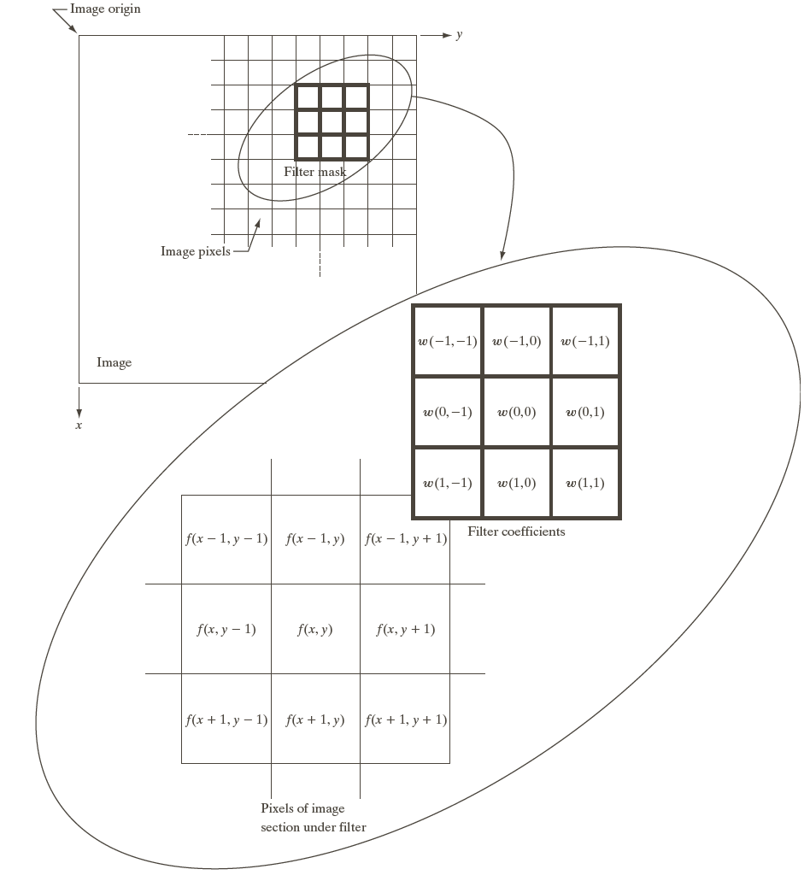
图像的空间滤波：基本概念
空间滤波器(核)
卷积函数
Convolution between w() and f()

Slide 9


图像的空间滤波：演示

Slide 10
图像滤波示例：图像导数的计算
一阶导数
二阶导数

Slide 11
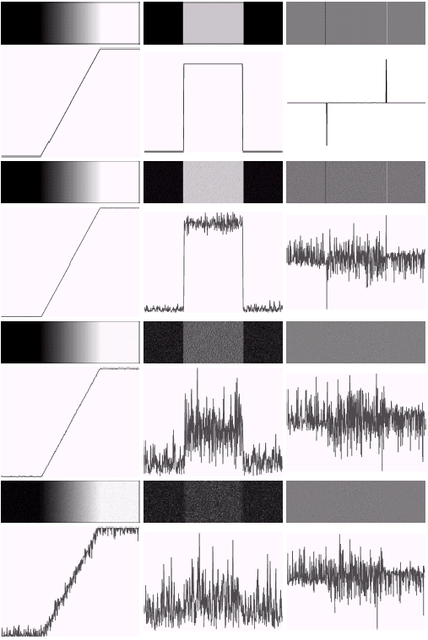
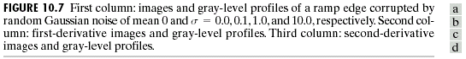
图像滤波示例：图像的微分运算放大噪声
通过图像滤波减低噪声
Canny, J., A Computational Approach To Edge Detection, IEEE Trans. Pattern Analysis and Machine Intelligence, 8(6):679–698, 1986.
Gonzalez & Woods, DIP 2/e

Slide 12
一个低通滤波器的例子：均值滤波

Slide 13
图像滤波的数学模型
一个图像滤波器可以描述为一个线性系统
f(x,y)
w(x,y)
g(x,y)
http://www.imageprocessingplace.com/
Oppenheim et al, Signals & Systems, 1997

Slide 14
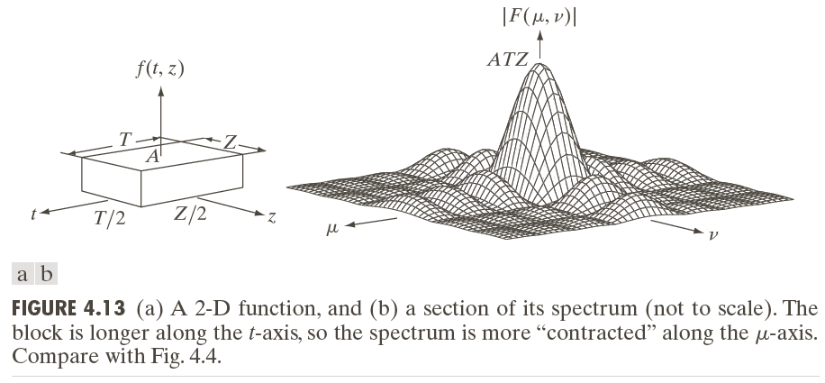
均值滤波器的频率域模型 (I)
均值滤波器的频率域形式

Slide 15
均值滤波器的频率域模型 (II)

Slide 16
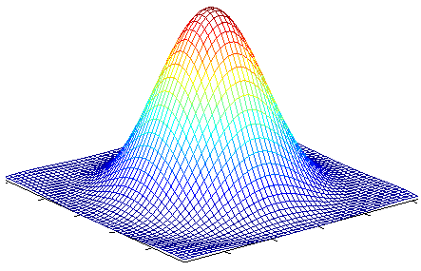
高斯滤波器 (I)
一维和二维高斯滤波核
一阶导数
二阶导数

Slide 17
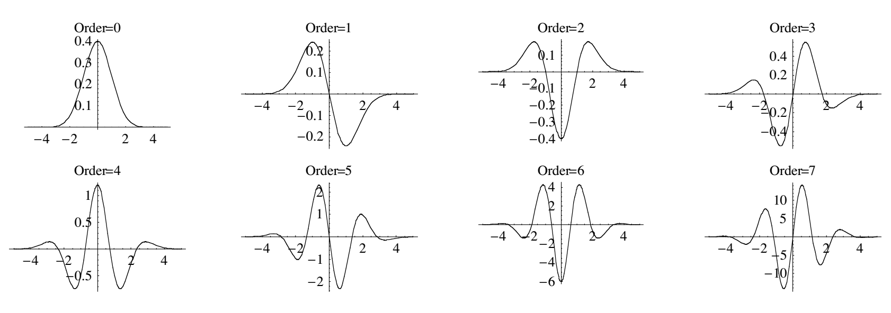
高斯滤波器 (II)
http://bmia.bmt.tue.nl/Education/Courses/FEV/book/pdf/04%20Gaussian%20derivatives.pdf

Slide 18
高斯滤波器 (III)
高斯滤波器的基本特性
- 它是一个低通滤波器
- 它是一个可分式滤波器

Slide 19
高斯滤波器 (IV)

Slide 20
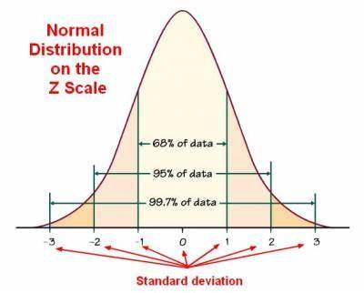
确定高斯滤波器的大小
滤波器大小=round_up(3×σ)*2 + 1

Slide 21
使用高斯滤波核下噪声压制与导数计算的简化
Implementation
Notation: I: raw image; J: filtered image after convolution with Gaussian kernel G.
A basic property of convolution

Slide 22
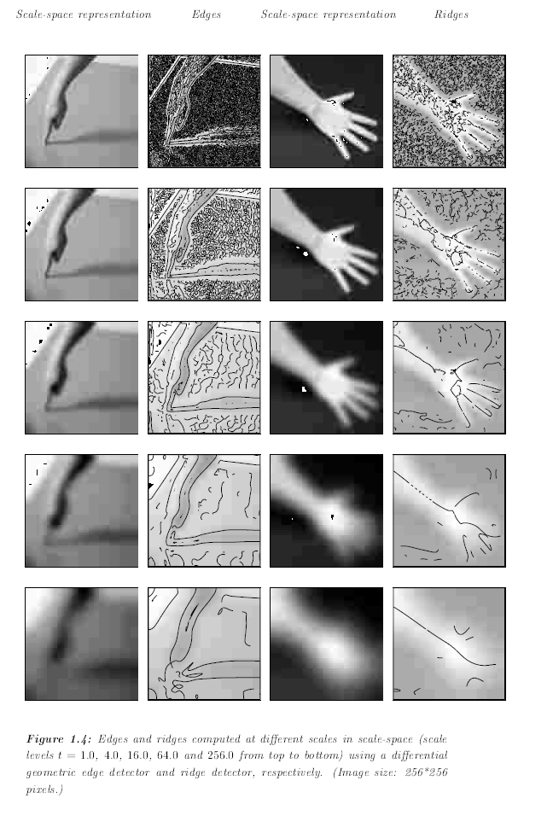
高斯滤波器与图像空间尺度
Lindeberg (1999) `` Principles for automatic scale selection'', in: B. Jahne (et al., eds.), Handbook on Computer Vision and Applications, volume 2, pp 239--274, Academic Press.

Slide 23
图像滤波和高斯滤波器
图像采样定理
图像的二维离散傅里叶变换
图像的频率域滤波
图像的正交变换
卷积神经网络的基本结构
点扩散函数的基本概念
Notes:
As you will see again and again in the class, to understand bioimage informatics depends critically on understanding the biological background of bioimage informatics. This is because bioimage informatics is created to answer biological questions rather than for technological curiosity. If we do not understand the biological questions, we will not be able to understand bioimage informatics. So for this reason we need to build some background knowledge about biology, and specifically for this lecture about cell biology.
For the most part of this course, our discussion on biology will be on a level that will be quite comfortable for you.
After that I will give you some historical perspectives and talk about where does it come from. Then I will discuss the learning objectives that we plan to achieve in this class. And finally I will go through the course syllabus together with you and discuss some details.

Slide 24
傅里叶级数与傅里叶变换 (I)
傅里叶级数

Slide 25
傅里叶级数与傅里叶变换 (II)
傅里叶变换

Slide 26
脉冲信号的筛选特性

Slide 27
卷积的一个基本属性

Slide 28
采样信号的数学表示及其傅里叶变换 (I)

Slide 29
采样定理 (I)

Slide 30
采样定理 (II)
一个连续和有限带宽的信号可以从其采样信号中完全回复如果采样频率超过了其带宽极限频率的两倍。

Slide 31
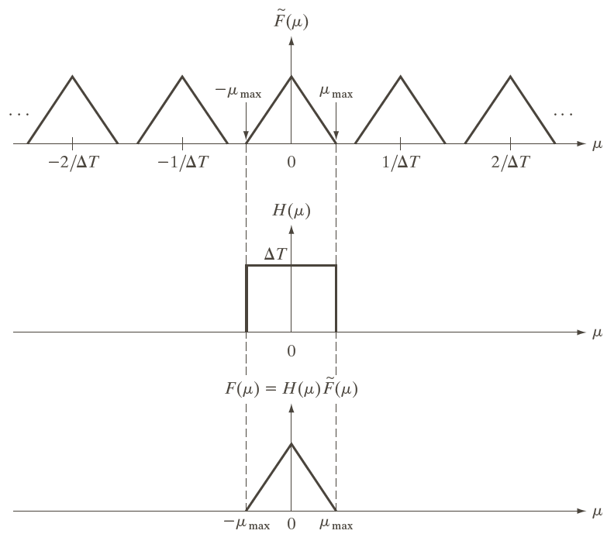
采样定理 (III)

Slide 32
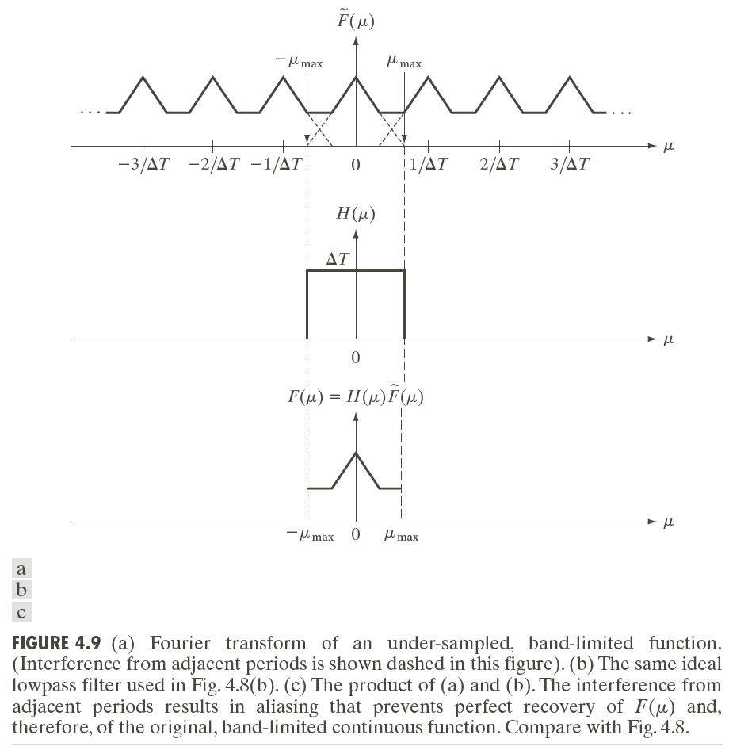
采样定理 (IV)

Slide 33
信号采样中的混淆现象

Slide 34
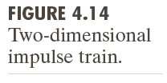
图像采样中的二维采样脉冲序列

Slide 35
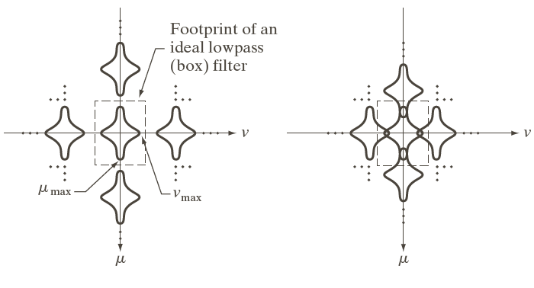
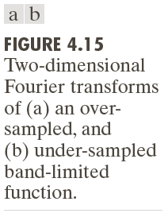
图像二维采样中的混淆现象

Slide 36
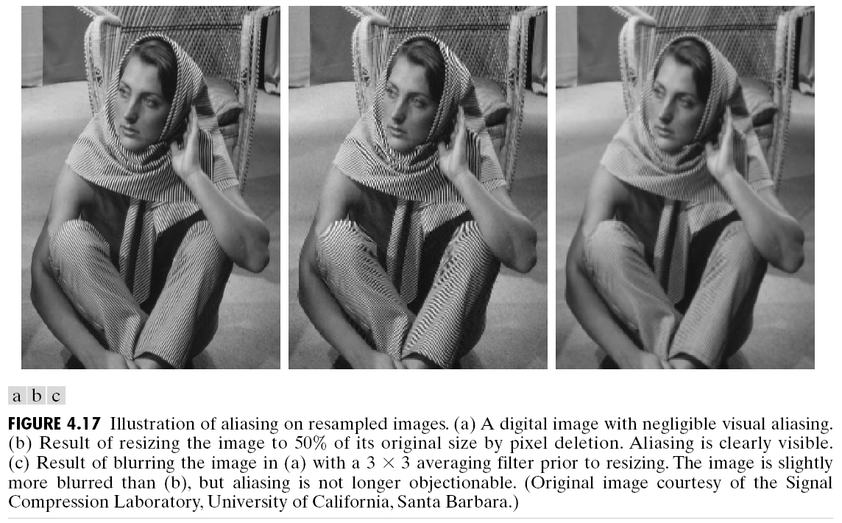
图像采样中的混淆现象

Slide 37
图像滤波和高斯滤波器
图像采样定理
图像的二维离散傅里叶变换
图像的频率域滤波
图像的正交变换
卷积神经网络的基本结构
点扩散函数的基本概念
Notes:
As you will see again and again in the class, to understand bioimage informatics depends critically on understanding the biological background of bioimage informatics. This is because bioimage informatics is created to answer biological questions rather than for technological curiosity. If we do not understand the biological questions, we will not be able to understand bioimage informatics. So for this reason we need to build some background knowledge about biology, and specifically for this lecture about cell biology.
For the most part of this course, our discussion on biology will be on a level that will be quite comfortable for you.
After that I will give you some historical perspectives and talk about where does it come from. Then I will discuss the learning objectives that we plan to achieve in this class. And finally I will go through the course syllabus together with you and discuss some details.

Slide 38
二维连续与离散傅里叶变换
二维连续傅里叶变换
二维离散傅里叶变换

Slide 39
二维离散傅里叶变换的概念与基本特性 (I)

Slide 40
二维离散傅里叶变换的概念与基本特性 (II)

Slide 41
二维离散傅里叶变换的概念与基本特性 (III)

Slide 42
二维离散傅里叶变换的概念与基本特性 (IV)

Slide 43
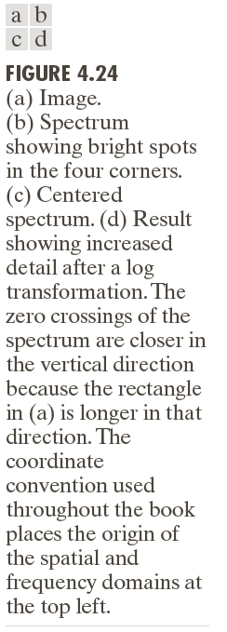
图像2D-DFT示例 (I)

Slide 44
图像2D-DFT示例 (II)

Slide 45
图像2D-DFT示例 (III)

Slide 46
图像滤波和高斯滤波器
图像采样定理
图像的二维离散傅里叶变换
图像的频率域滤波
图像的正交变换
卷积神经网络的基本结构
点扩散函数的基本概念
Notes:
As you will see again and again in the class, to understand bioimage informatics depends critically on understanding the biological background of bioimage informatics. This is because bioimage informatics is created to answer biological questions rather than for technological curiosity. If we do not understand the biological questions, we will not be able to understand bioimage informatics. So for this reason we need to build some background knowledge about biology, and specifically for this lecture about cell biology.
For the most part of this course, our discussion on biology will be on a level that will be quite comfortable for you.
After that I will give you some historical perspectives and talk about where does it come from. Then I will discuss the learning objectives that we plan to achieve in this class. And finally I will go through the course syllabus together with you and discuss some details.

Slide 47
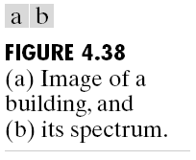
图像频率域滤波的基本概念 (I)

Slide 48
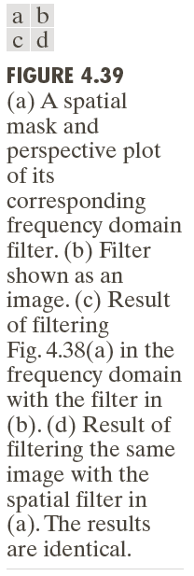
图像频率域滤波的基本概念 (II)

Slide 49
图像频率域滤波的基本步骤
给定一个输入图像 f(x,y), 计算对应的2D-DFT F(u,v)
在频率域构建一个滤波器 H(u,v)
计算 G(u,v)=H(u,v)F(u,v)
计算G(u,v)的2D-IDFT,得到输出图像

Slide 50
代表性滤波器：理想低通滤波器 ILPF

Slide 51
滤波样本图像

Slide 52
滤波结果: 理想低通滤波器 ILPF

Slide 53
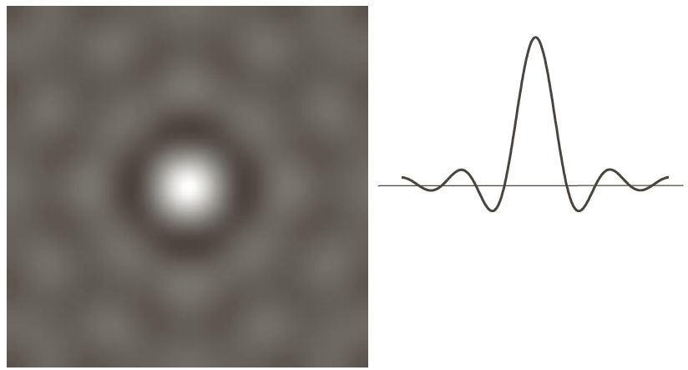
ILPF的空间域特性

Slide 54
代表性滤波器：高斯低通滤波器 GLPF

Slide 55
滤波结果：高斯低通滤波器 GLPF

Slide 56
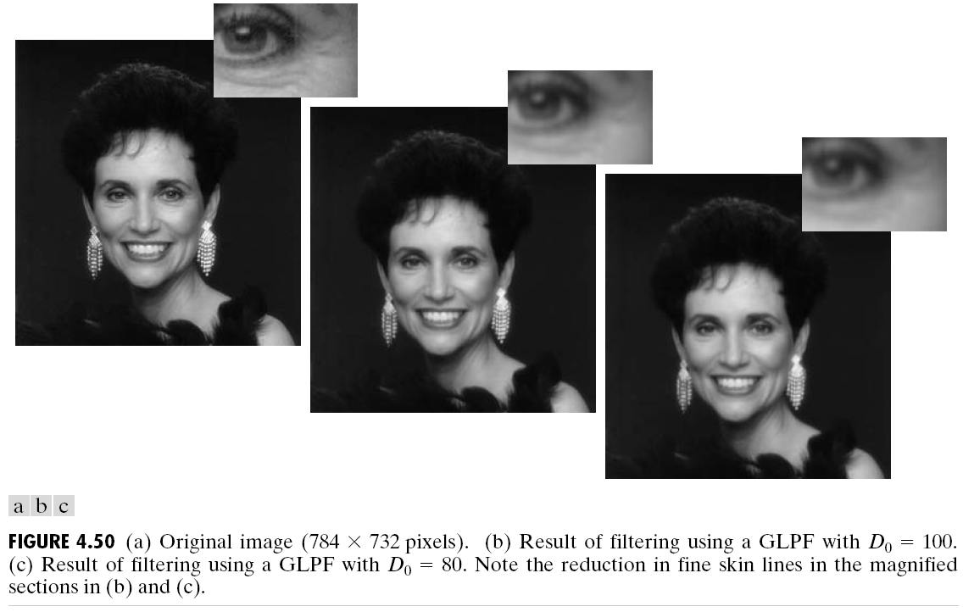
滤波结果：高斯低通滤波器 GLPF

Slide 57
滤波结果：高斯低通滤波器 GLPF

Slide 58
代表性滤波器：巴特沃斯低通滤波器 BLPF

Slide 59
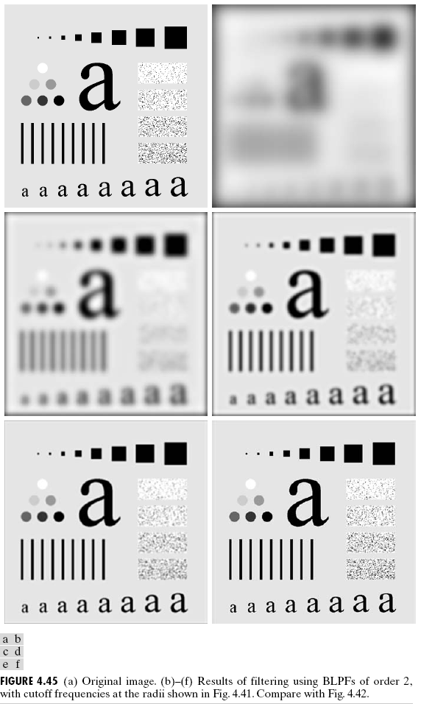
滤波结果：巴特沃斯低通滤波器 BLPF

Slide 60
BLPF的空间域特性

Slide 61
图像滤波和高斯滤波器
图像采样定理
图像的二维离散傅里叶变换
图像的频率域滤波
图像的正交变换
卷积神经网络的基本结构
点扩散函数的基本概念
Notes:
As you will see again and again in the class, to understand bioimage informatics depends critically on understanding the biological background of bioimage informatics. This is because bioimage informatics is created to answer biological questions rather than for technological curiosity. If we do not understand the biological questions, we will not be able to understand bioimage informatics. So for this reason we need to build some background knowledge about biology, and specifically for this lecture about cell biology.
For the most part of this course, our discussion on biology will be on a level that will be quite comfortable for you.
After that I will give you some historical perspectives and talk about where does it come from. Then I will discuss the learning objectives that we plan to achieve in this class. And finally I will go through the course syllabus together with you and discuss some details.

Slide 62
矢量空间的基本概念
一个定义在域F上的矢量空间V, 对于所有的
满足如下条件

Slide 63
内积空间的基本概念
如果矢量空间V满足如下条件则是一个内积空间

Slide 64
内积空间的单位正交基

Slide 65
一维信号的正交变换
定义

Slide 66
一维信号的正交变换的矩阵形式

Slide 67
二维信号的正交变换的矩阵形式

Slide 68
图像滤波和高斯滤波器
图像采样定理
图像的二维离散傅里叶变换
图像的频率域滤波
图像的正交变换
卷积神经网络的基本结构
点扩散函数的基本概念
Notes:
As you will see again and again in the class, to understand bioimage informatics depends critically on understanding the biological background of bioimage informatics. This is because bioimage informatics is created to answer biological questions rather than for technological curiosity. If we do not understand the biological questions, we will not be able to understand bioimage informatics. So for this reason we need to build some background knowledge about biology, and specifically for this lecture about cell biology.
For the most part of this course, our discussion on biology will be on a level that will be quite comfortable for you.
After that I will give you some historical perspectives and talk about where does it come from. Then I will discuss the learning objectives that we plan to achieve in this class. And finally I will go through the course syllabus together with you and discuss some details.

Slide 69
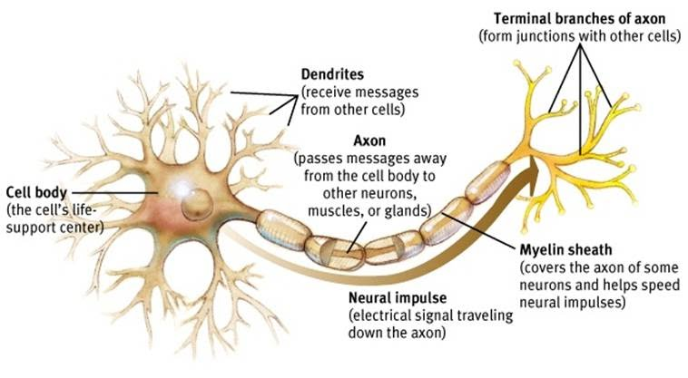
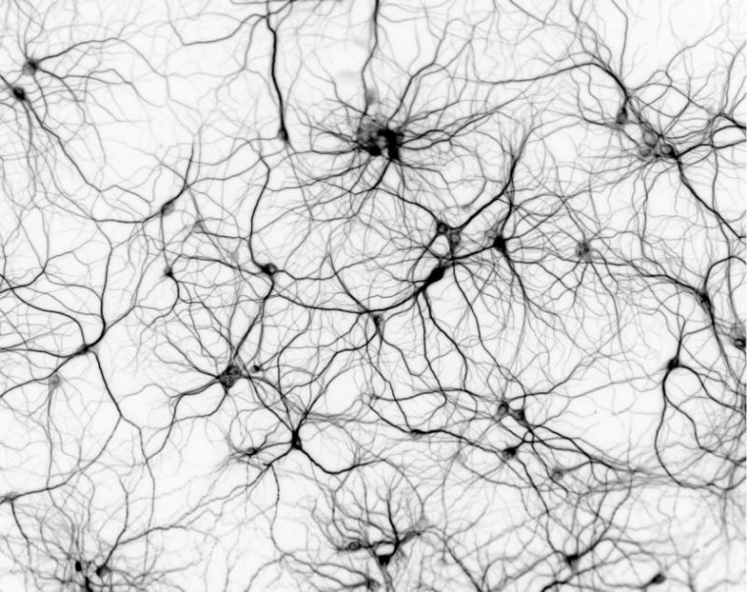
生物神经网络
https://sites.google.com/site/mrstevensonstechclassroom/hl-topics-only/4a-robotics-ai/neural-networks-computational-intelligence

Slide 70
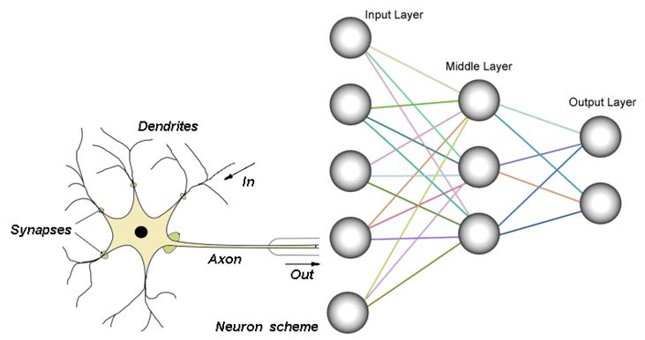
生物与人工神经网络的比较
https://sites.google.com/site/mrstevensonstechclassroom/hl-topics-only/4a-robotics-ai/neural-networks-computational-intelligence

Slide 71
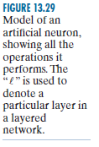
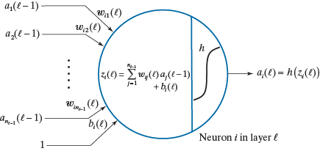
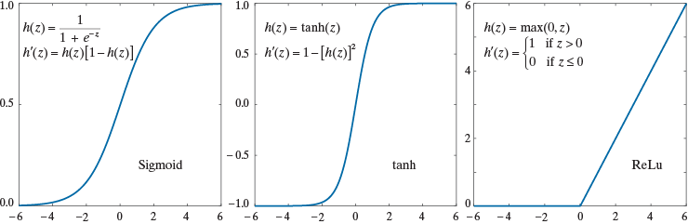
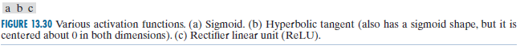
一个人工神经元模型

Slide 72
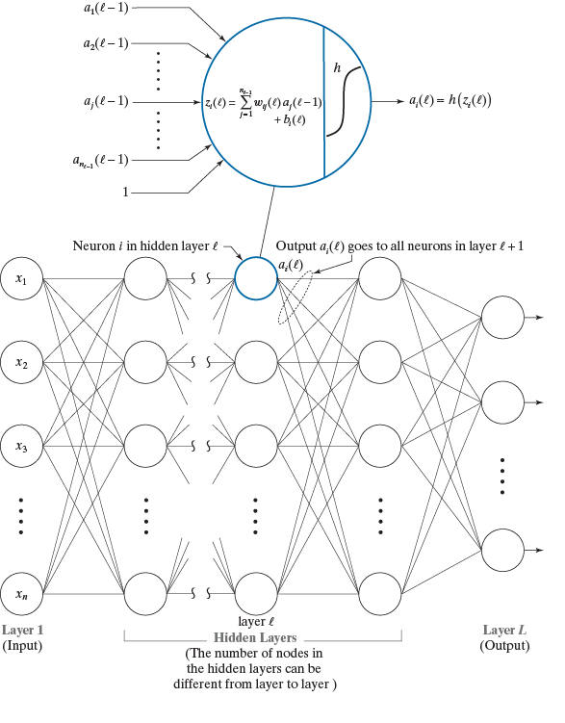
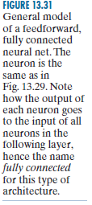
全连接前馈人工神经网络

Slide 73
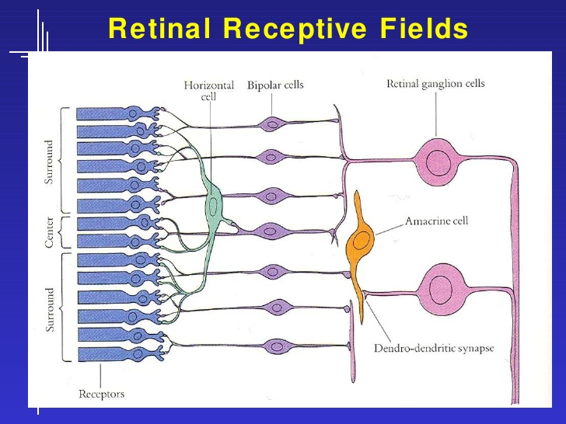
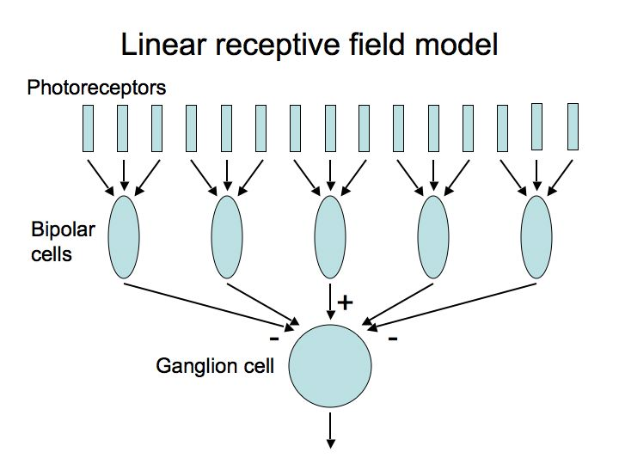
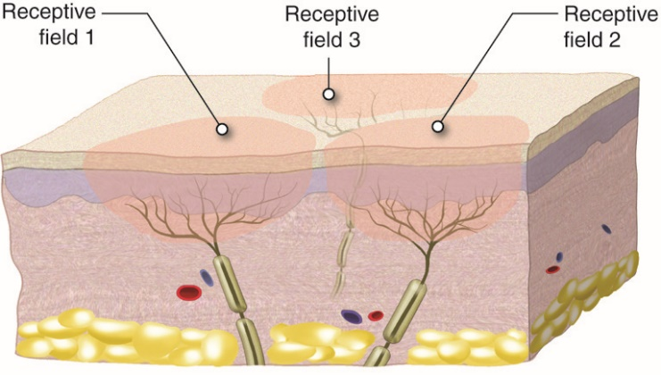
感受野的概念性介绍
https://www.cns.nyu.edu/~david/courses/perception/lecturenotes/ganglion/ganglion.html

Slide 74
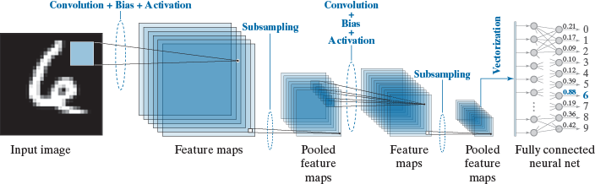
卷积神经网络示例：LeNet
http://yann.lecun.com/exdb/lenet/
Y. LeCun, L. Bottou, Y. Bengio, and P. Haffner. Gradient-based learning applied to document recognition.Proceedings of the IEEE, november 1998.

Slide 75
卷积神经网络简介

Slide 76
参考文献
Convolutional neural network for visual recognition http://cs231n.stanford.edu/
LeCun, Bengio, Hinton, Deep Learning, Nature, 2015.
Zeiler & Fergus, Visualizing and understanding Convolutional Networks, ECCV 2014

Slide 77
卷积神经网络概述

Slide 78
卷积神经网络的神经生物学基础

Slide 79
为什么采用卷积神经网络？

Slide 80
CNN的典型结构

Slide 81
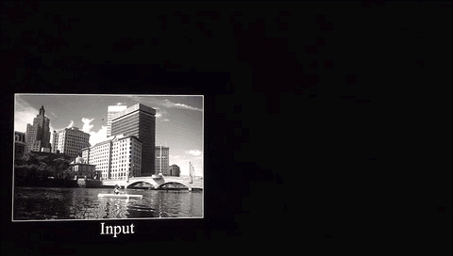

卷积层：提取图像特征
https://ujjwalkarn.me/2016/08/11/intuitive-explanation-convnets/

Slide 82
非线性单元：ReLU (I)

Slide 83

非线性单元：ReLU (II)
应用于每个像素，将所有的负灰度值换为0.
https://ujjwalkarn.me/2016/08/11/intuitive-explanation-convnets/

Slide 84
Pooling 池化 (I)

Slide 85
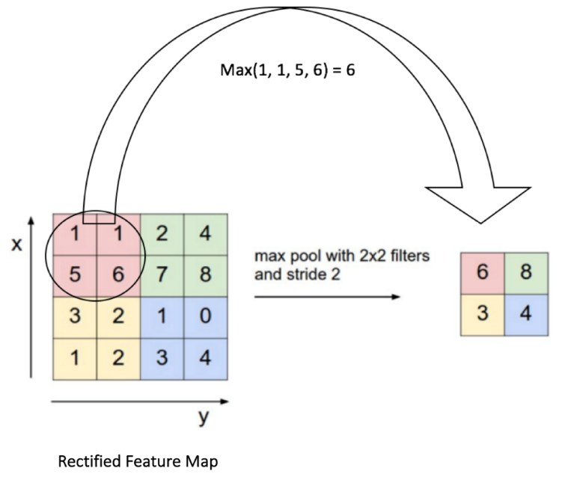
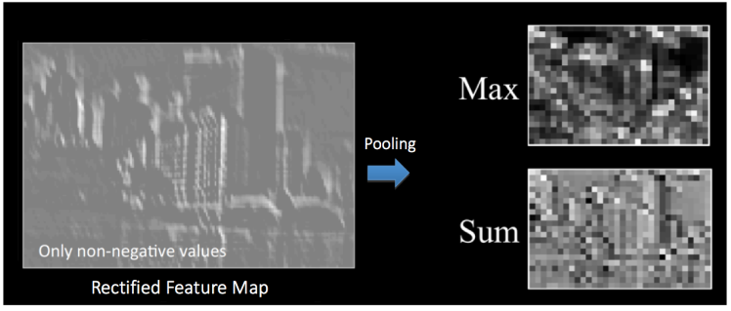
Pooling 池化 (II)
https://ujjwalkarn.me/2016/08/11/intuitive-explanation-convnets/

Slide 86
Softmax

Slide 87
软件形态的变化

Slide 88
图像滤波和高斯滤波器
图像采样定理
图像的二维离散傅里叶变换
图像的频率域滤波
图像的正交变换
卷积神经网络的基本结构
点扩散函数的基本概念
Notes:
As you will see again and again in the class, to understand bioimage informatics depends critically on understanding the biological background of bioimage informatics. This is because bioimage informatics is created to answer biological questions rather than for technological curiosity. If we do not understand the biological questions, we will not be able to understand bioimage informatics. So for this reason we need to build some background knowledge about biology, and specifically for this lecture about cell biology.
For the most part of this course, our discussion on biology will be on a level that will be quite comfortable for you.
After that I will give you some historical perspectives and talk about where does it come from. Then I will discuss the learning objectives that we plan to achieve in this class. And finally I will go through the course syllabus together with you and discuss some details.

Slide 89
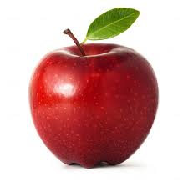
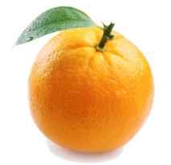
A Microscope as a Linear System
A light microscope can be considered as a linear system.
A linear system satisfies the following two conditions
- Homogeneity
- Additivity
Homogeneity
Additivity

Slide 90
How to Characterize a Linear System
A linear system can be characterized by
- Impulse response
- Frequency response
Impulse response of a microscope: point spread function
Frequency response of a microscope: optical transfer function

Slide 91
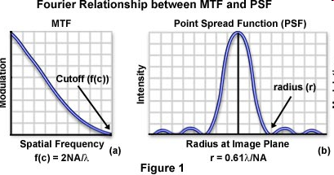
Airy Disk
Airy (after George Biddell Airy) disk is the diffraction pattern of a point feature under a circular aperture.
It has the following form
Detailed derivation is given in Born & Wolf, Principles of Optics, 7th ed., pp. 439-441.
J₁(x) is a Bessel function of the first kind.

Slide 92

Microscope Image Formation (I)
Microscope image formation can be modeled as a convolution with the PSF.
http://micro.magnet.fsu.edu/primer/java/mtf/airydisksize/index.html

Slide 93
Microscope Image Formation (II)
The impulse response of the microscope is called its point spread function (PSF).
The transfer function of a microscope is called its optical transfer function (OTF).
The PSF has the shape of an Airy Disk.

Slide 94
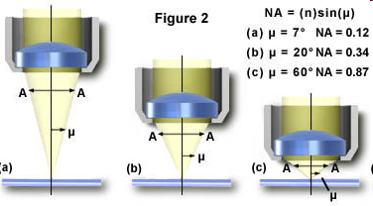
Numerical Aperture
Numerical aperture (NA) determines microscope resolution and light collection power.
n: refractive index of the medium between the lens and the specimen
μ: half of the angular aperture

Slide 95
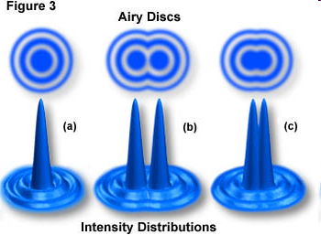
Different Definition of Light Microscopy Resolution Limit (Demo)
Rayleigh limit
Sparrow limit
http://www.microscopy.fsu.edu/primer/java/imageformation/rayleighdisks/index.html

Slide 96
Summary: High Resolution Microscopy
Size of cellular features are typically on the scale of a micron or smaller.
To resolve such features require
- Shorter wavelength (electron microscopy) - High numerical aperture (resolution) - High magnification (spatial sampling)

Slide 97
Questions?

